Slide 1
Machine Learning
& Ethics
William Seymour | Human Centred Computing
william.seymour@cs.ox.ac.uk

Slide 2



Hello!
3rd year PhD student in Human Centred Computing
Help teach Imperative Programming and Computer Security modules
Sideline in competitive security (hacking/lockpicking)
Everything you see today will be online at https://github.com/mcnutty26/uniq

Slide 3
Overview
Introduction to Machine Learning (13:30-14:10, Access Grid)
ML vs AI vs algorithms
Regression
Decision trees
Random forests
Neural networks
Practical: Building a Classifier (14:20-15:00, Comlab)
Primer on R and RStudio
Training and testing classifiers
Leaderboard competition
Ethics in Machine Learning (15:10-15:50, Access Grid)
Practical : Operationalising Ethics (16:00-16:30, Comlab)

Slide 4
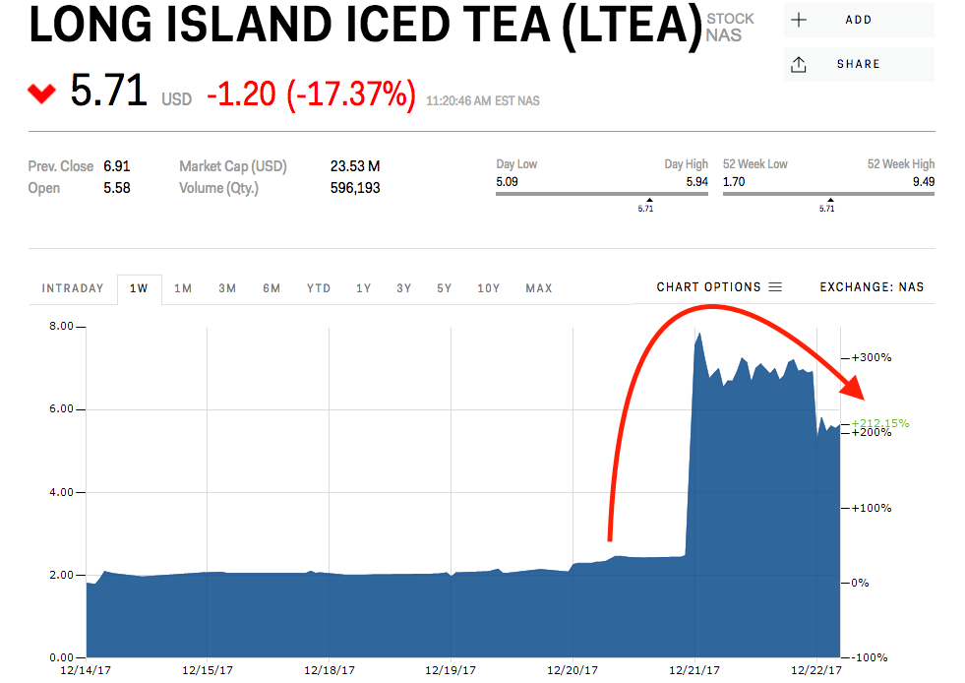
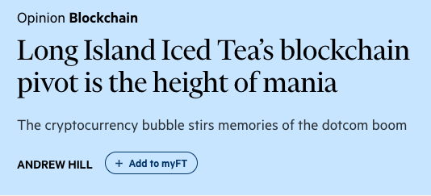
In other words, plan your startup now...
Algorithms
Choose a problem
Use “machine learning” to solve it
???
Profit
AI
ML

Slide 5
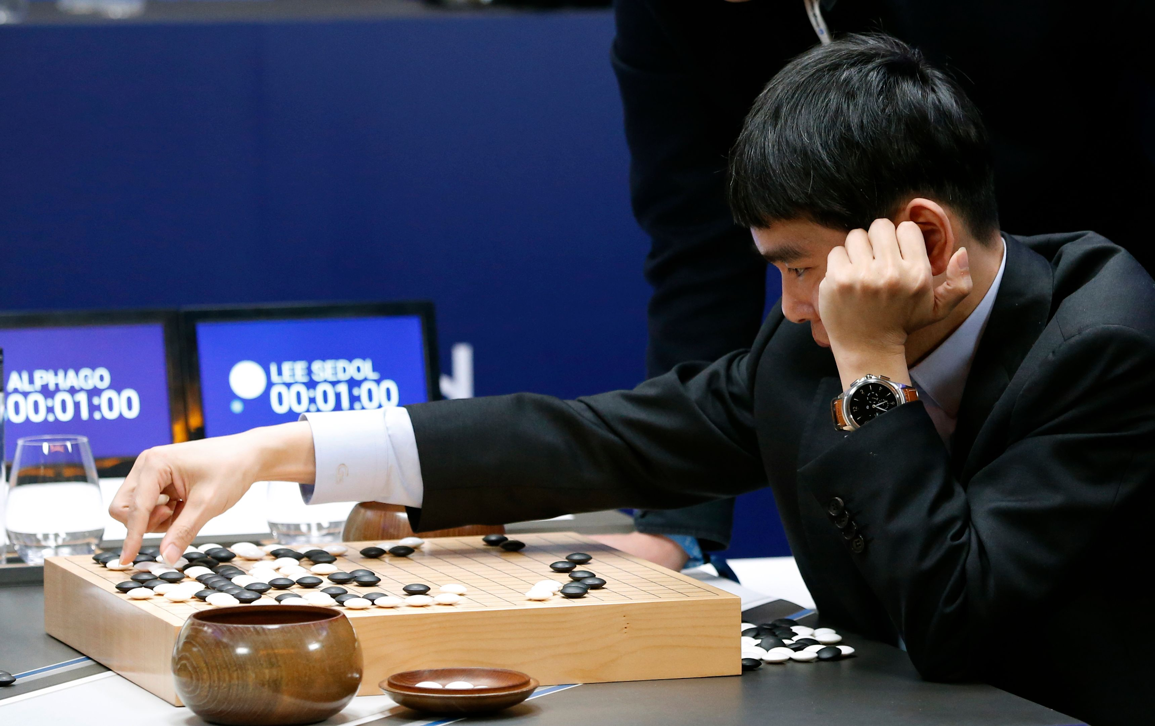
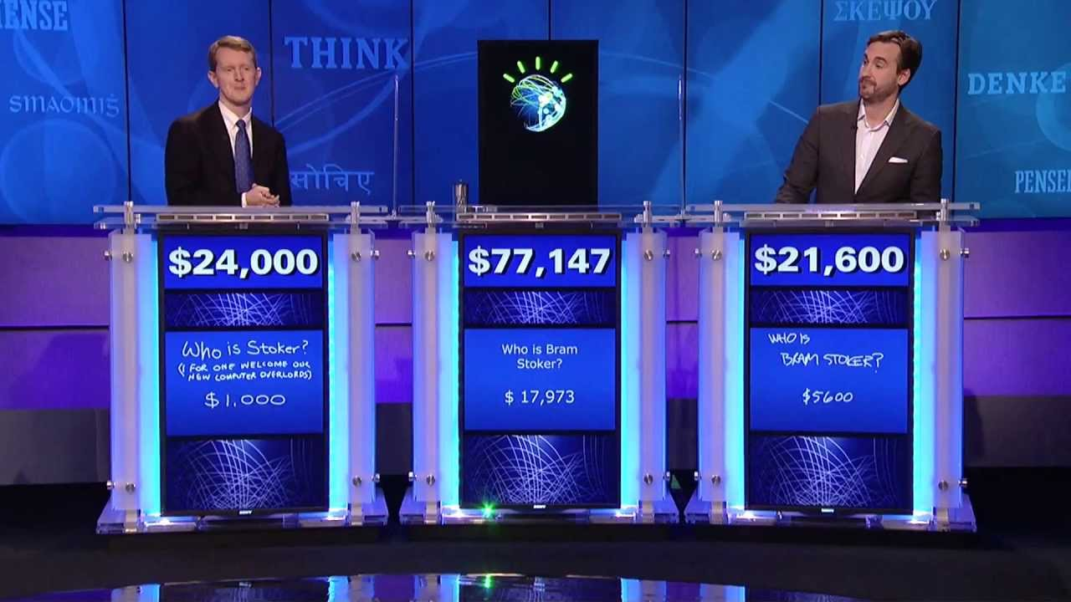
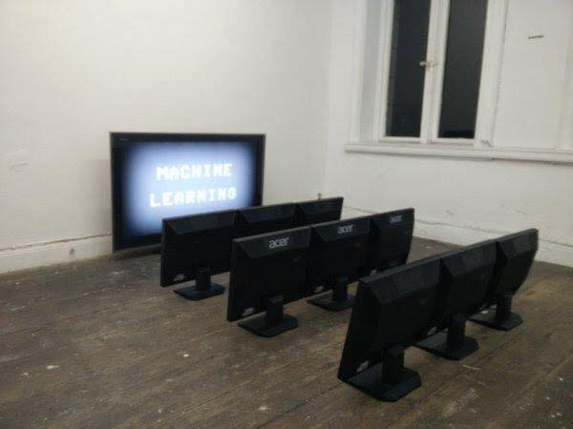
What even is “machine learning”?

Slide 6
“Using statistical methods to have programs improve over time”

Slide 7
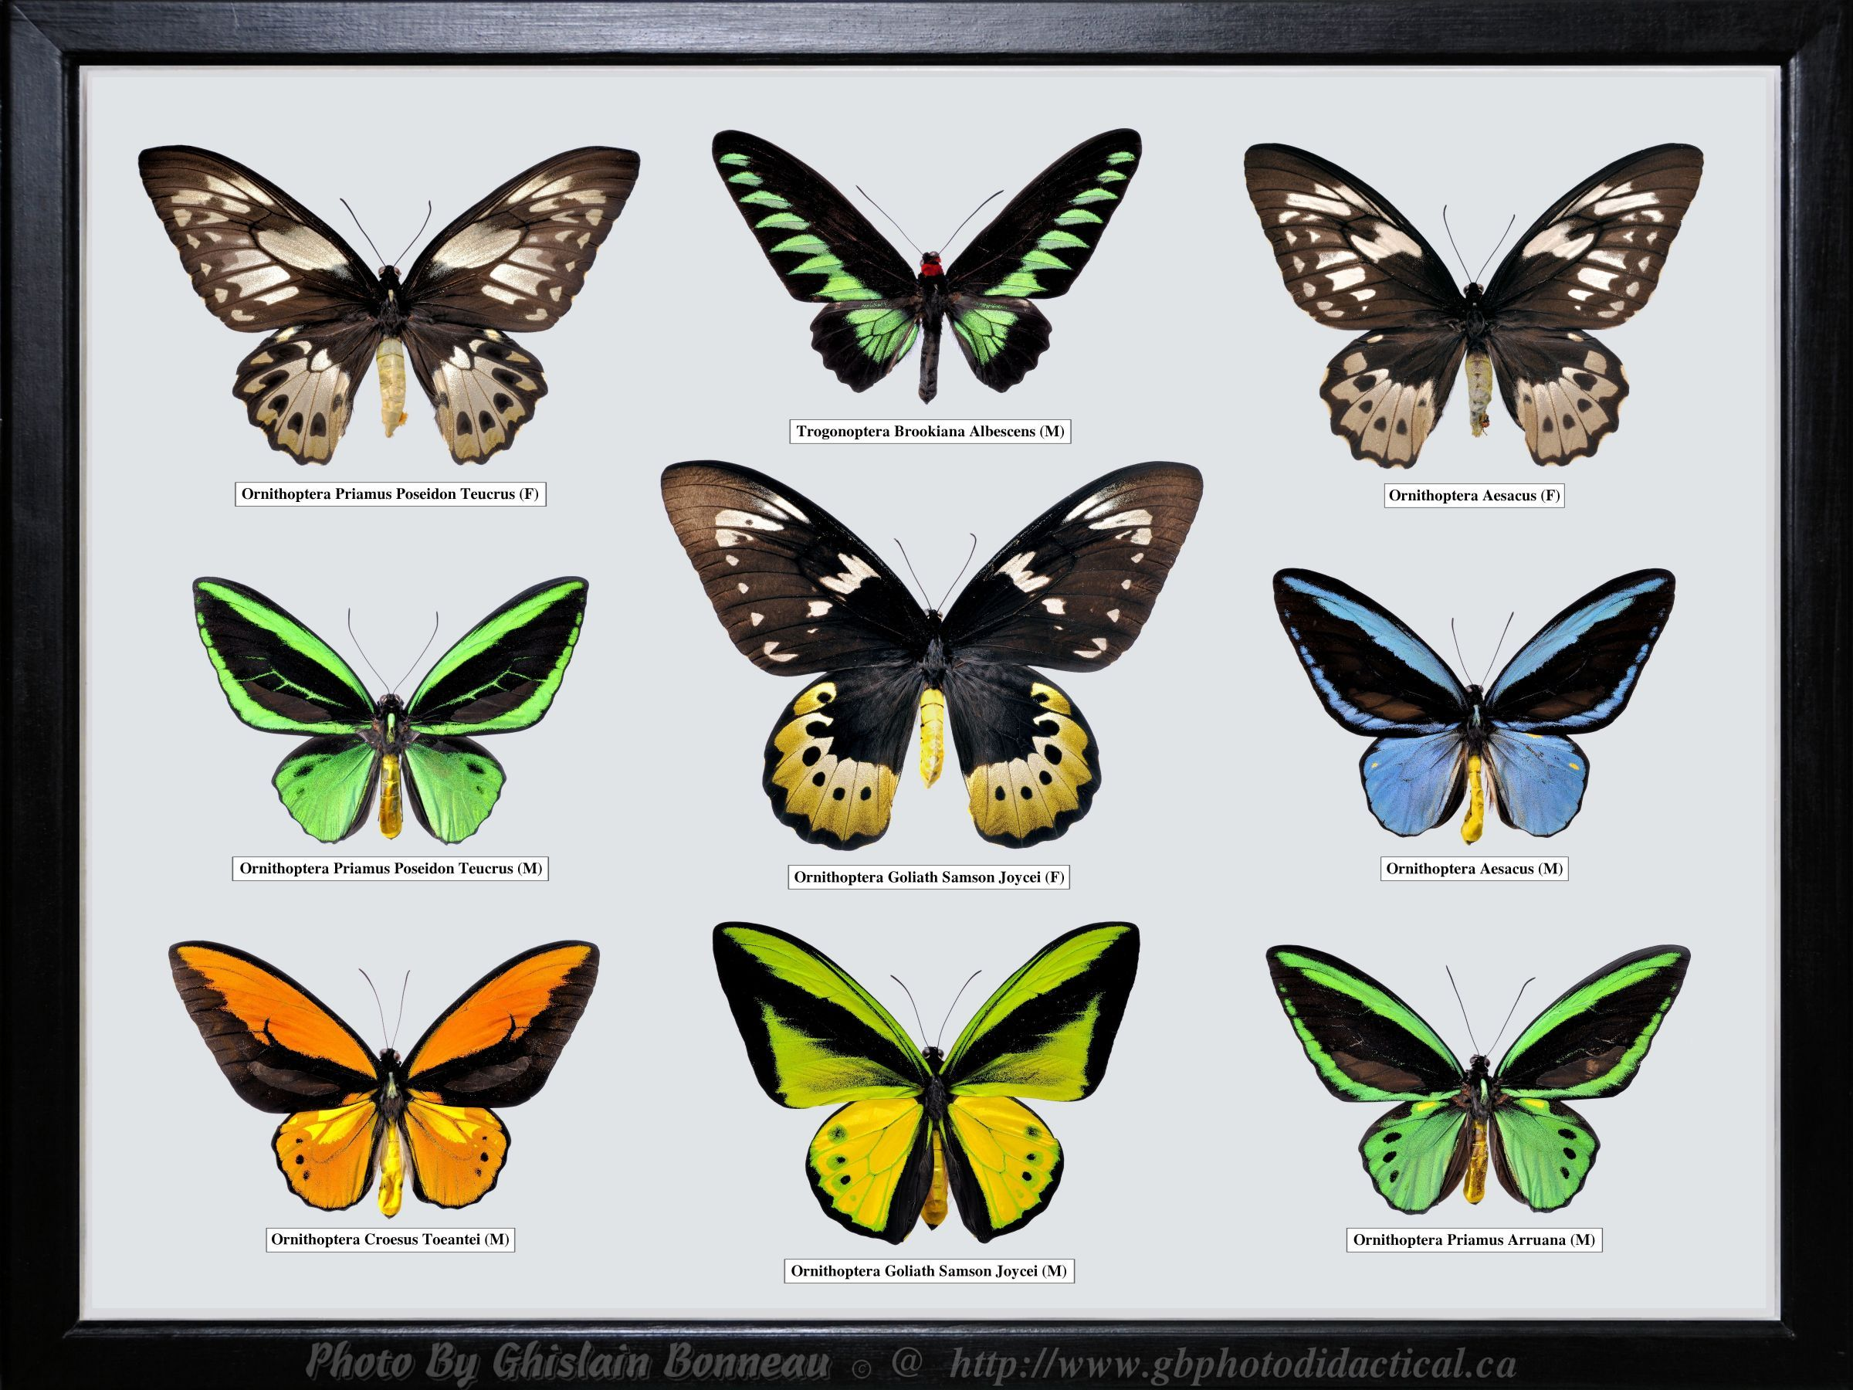

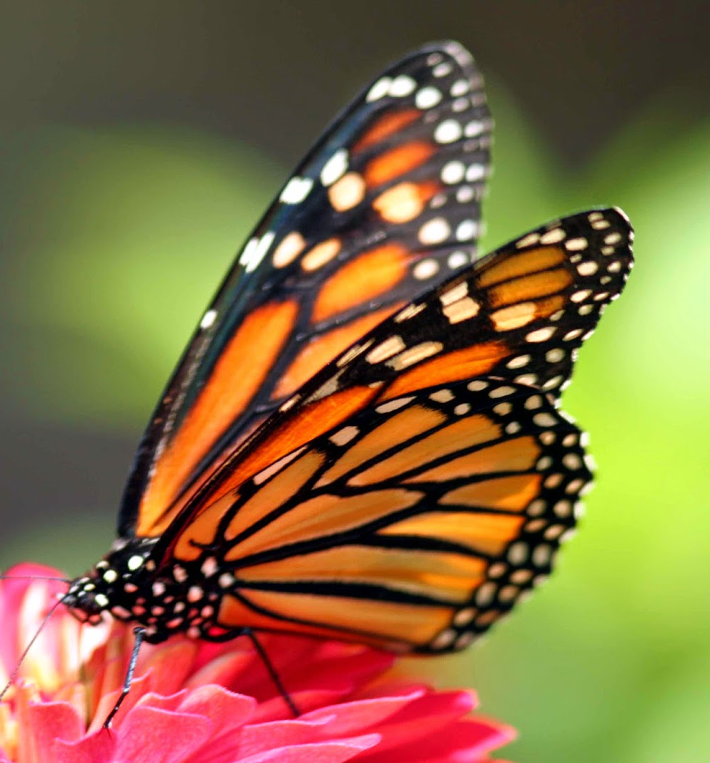



supervised
unsupervised

Slide 8
Accuracy
Notes:
F score is sometimes used as a combination of precision and recall

Slide 9

Accuracy is just a percentage, right?

Slide 10

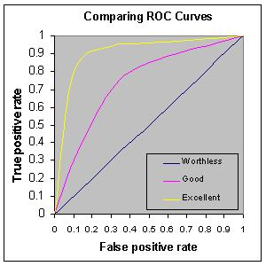
Accuracy and Friends
Precision is the probability that a (random) result predicted positive is actually positive.
Recall is the probability that a (random) positive result is predicted positive.
Other options like ROC curves give us different information about a classifier
Notes:
F score is sometimes used as a combination of precision and recall

Slide 11
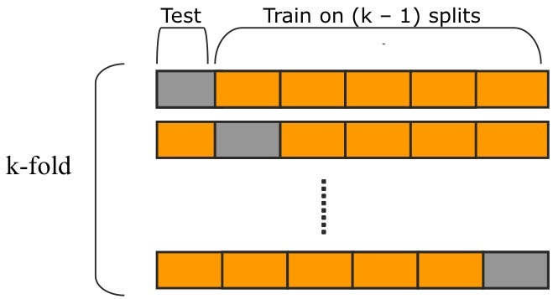
Training and Testing
You calculate these metrics using a test data set
Using the same data to test and train leads to “overfitting”
Various (better) options like train/test split and k-fold validation

Slide 12
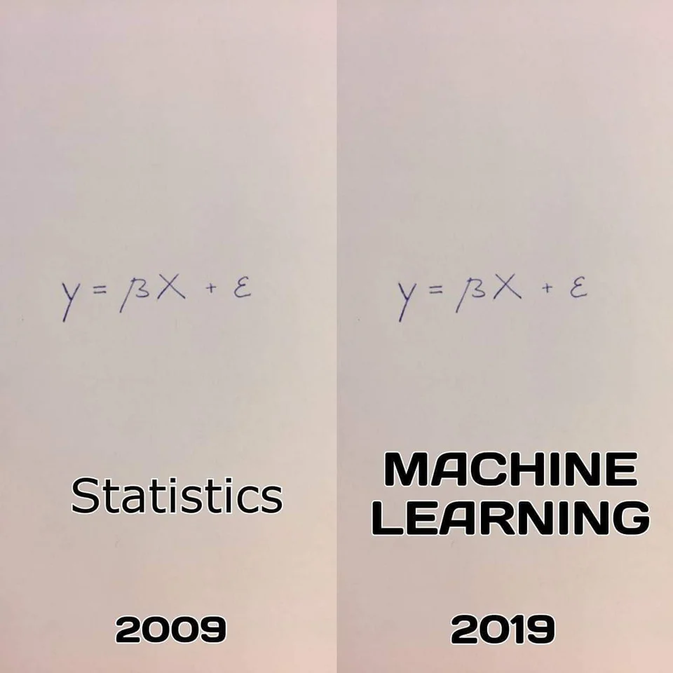
Regression

Slide 13
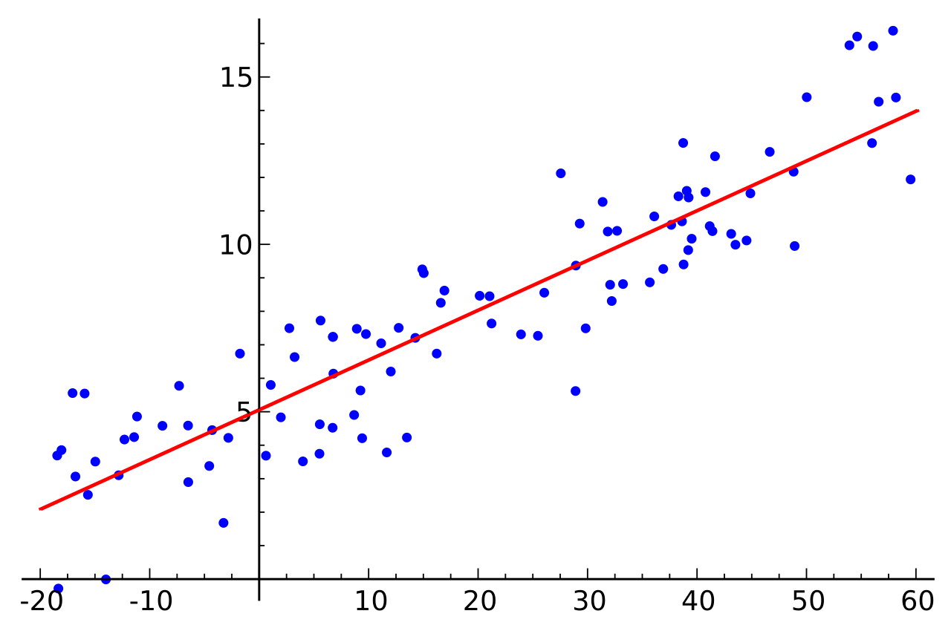
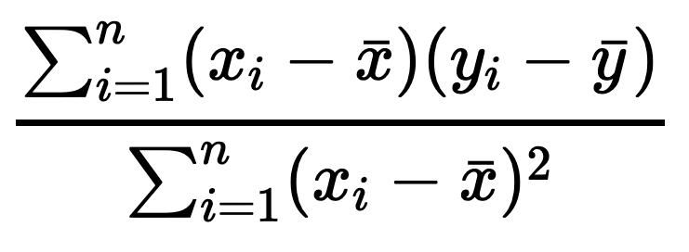
Linear Regression
Predict the values of numeric data
Linear regression same as in S1
y = ɑ + βx + 𝛄z + ...
Trying to minimise sum of squared errors when fitting the line
For a single independent variable:

Slide 14
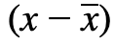
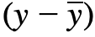
Linear Regression Example
Password | Numbers | Crack Time (s)
v3BYUAHbJA | 1 | 1.37
PMAXimkXNs | 0 | 0.52
nX37FkRcLL | 2 | 2.10
wQ5TpMXAOT | 1 | 1.92
bS9Qqtjyb0 | 2 | 2.84
sajWxrZqd9 | 1 | 1.65
dcLhGSrGJG | 0 | 0.45
fajY1MLD00 | 3 | 2.99
OQhMcTl8IA | 1 | 1.87
x4cu3tORHH | 2 | 2.43

Slide 15
Linear Regression Example
Password | Numbers | Crack Time (s)
v3BYUAHbJA | 1 | 1.37 | -0.3 | -0.43
PMAXimkXNs | 0 | 0.52 | -1.3 | -1.28
nX37FkRcLL | 2 | 2.10 | 0.7 | 0.3
wQ5TpMXAOT | 1 | 1.92 | -0.3 | 0.12
bS9Qqtjyb0 | 2 | 2.84 | 0.7 | 1.04
sajWxrZqd9 | 1 | 1.65 | -0.3 | -0.15
dcLhGSrGJG | 0 | 0.45 | -0.3 | -1.35
fajY1MLD00 | 3 | 2.99 | 1.7 | 1.19
OQhMcTl8IA | 1 | 1.87 | -0.3 | 0.07
x4cu3tORHH | 2 | 2.43 | 0.7 | 0.63
Average(x) = 1.3
Average(y) = 1.8
Sum of x errors = 1
Sum of y errors = 0.14
Sq. sum of x errors = 1
Coefficient = 0.14
Intercept = 1.66
Notes:
Intercept is ybar - coeff. times xbar

Slide 16
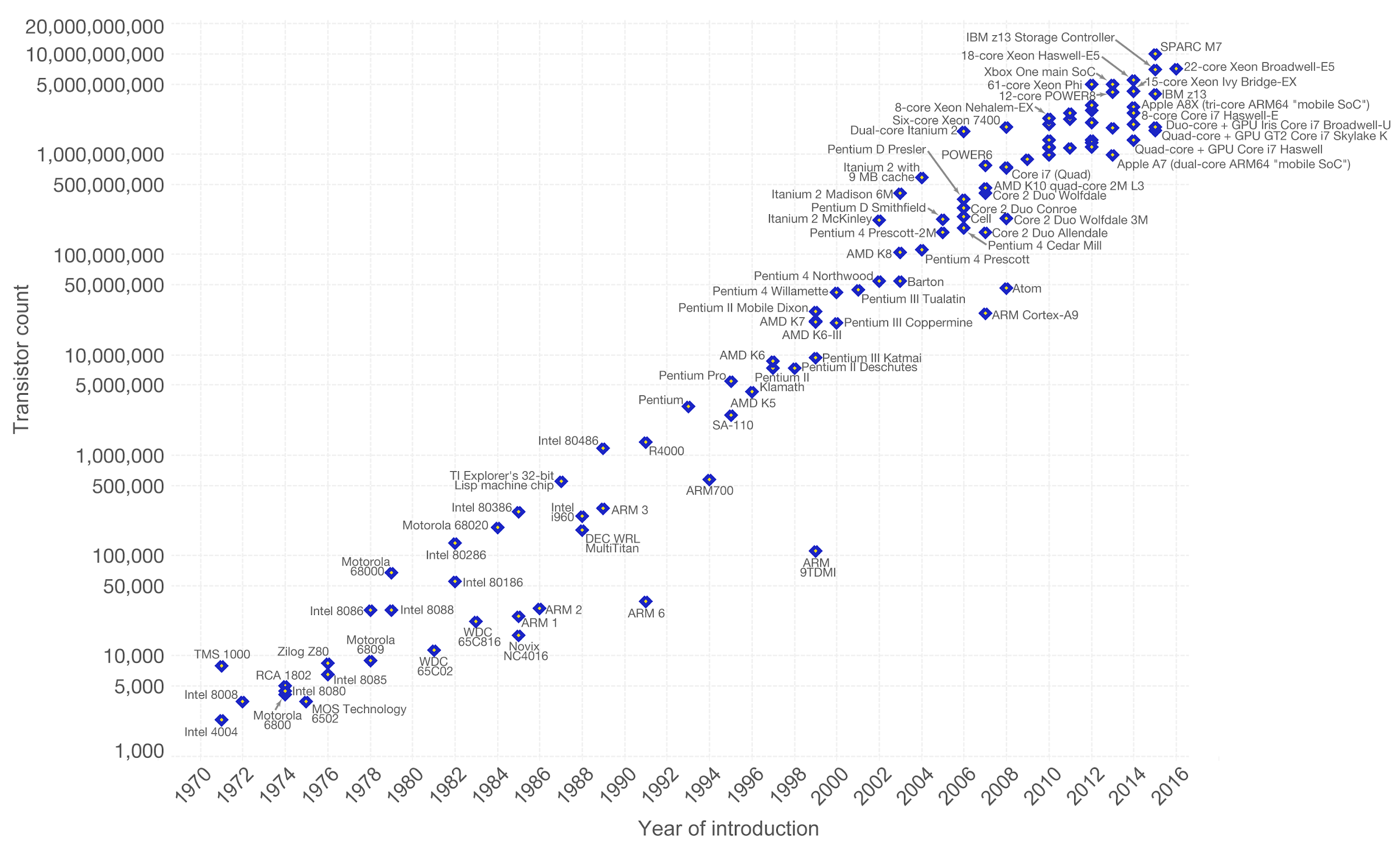
But, wait…
What if the relationship isn’t linear?

Slide 17
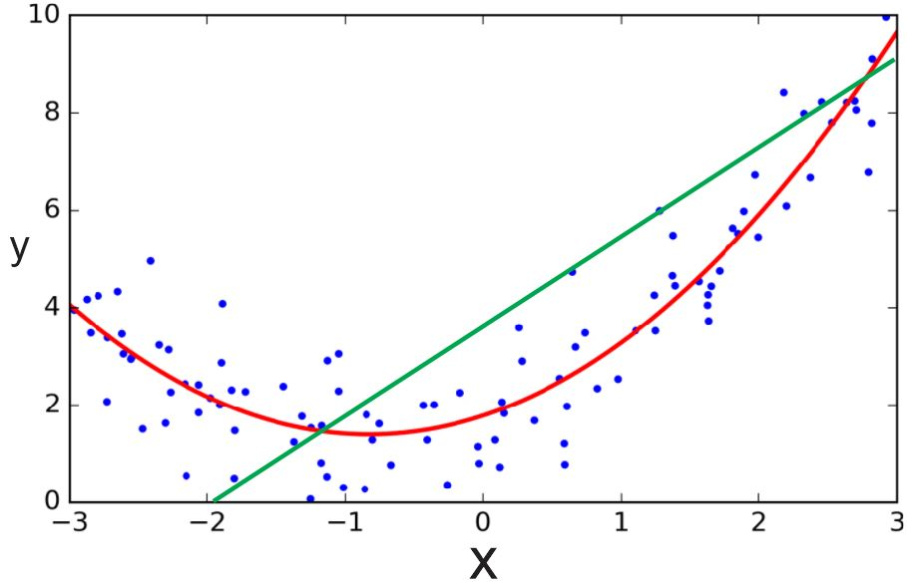
Polynomial and Logistic Regression
Commonly polynomial & logistic
Apply principles of linear regression to higher order relationships
Logistic regression deals with binary dependent variables (true/false)

Slide 18
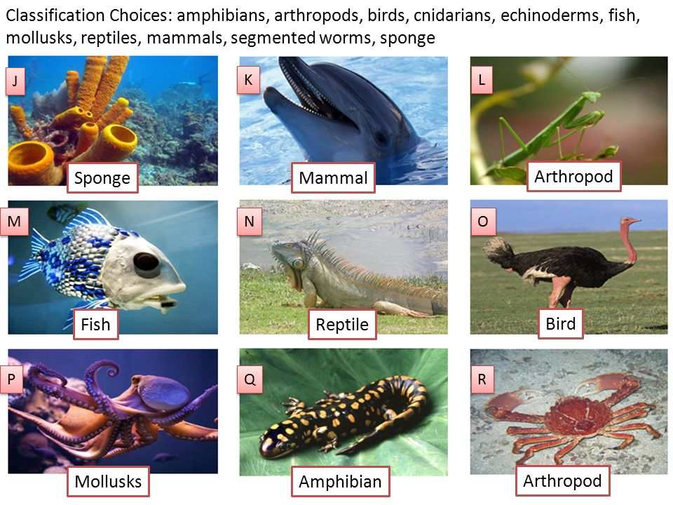
But, wait…
What if the independent variables aren’t numeric?

Slide 19
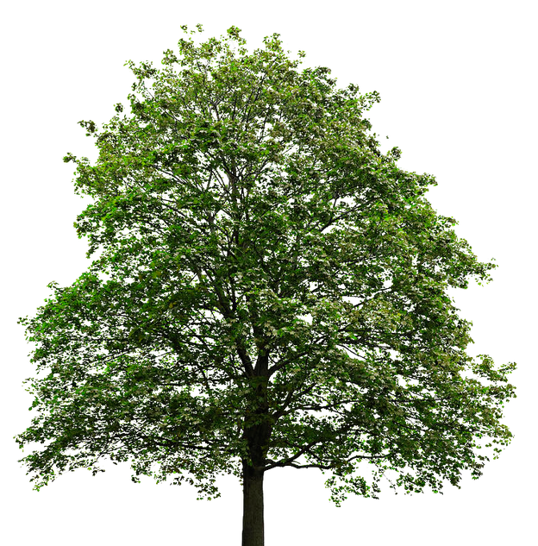
Trees and Forests

Slide 20
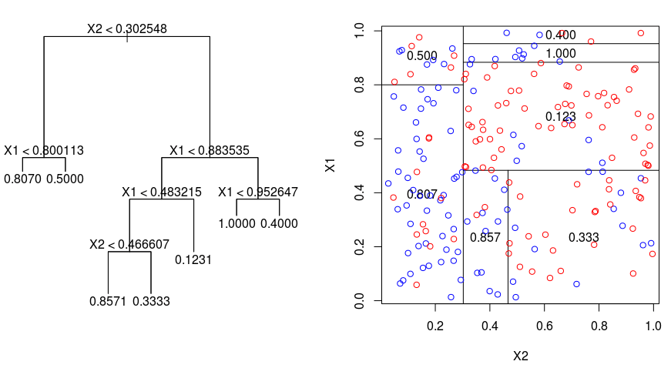
Decision Trees
Match categorical data to classes
Create an n-ary tree
Try to minimise incorrect classifications
Can also split on other functions such as information gain

Slide 21
CART for Decision Trees
Writing Hand | Multilingual | Plays Instrument
Right | No | No
Left | No | No
Right | Yes | Yes
Right | No | Yes
Right | Yes | Yes
Left | No | No
Left | Yes | Yes
Right | No | No
Right | Yes | No
Right | No | No
Split on writing hand?
p(I | L)² = (1/3)² = 0.11
P(¬I | L)² = (2/3)² = 0.44
p(I | R)² = (3/7)² = 0.18
p(¬I | R)² = (4/7)² = 0.33
Total L = 1 - 0.44 - 0.11 = 0.44
Total R = 1 - 0.18 - 0.33 = 0.49
Gini Index = (3(0.45)+7(0.49))/10
= 0.48

Slide 22
CART for Decision Trees
Writing Hand | Multilingual | Plays Instrument
Right | No | No
Left | No | No
Right | Yes | Yes
Right | No | Yes
Right | Yes | Yes
Left | No | No
Left | Yes | Yes
Right | No | No
Right | Yes | No
Right | No | No
Split on multilingual?
p(I | Y)² = (3/4)² = 0.56
P(¬I | Y)² = (1/4)² = 0.06
p(I | N)² = (1/6)² = 0.03
p(¬I | N)² = (5/6)² = 0.69
Total Y = 1 - 0.56 - 0.06 = 0.38
Total N = 1 - 0.03 - 0.69 = 0.28
Gini Index = (4(0.38)+6(0.28))/10
= 0.32

Slide 23
CART for Decision Trees
Gini index for writing hand was 0.48
Gini index for multilingual was 0.32
Therefore we should split by writing hand
Note: the highest possible Gini index for binary variables is
1 - (0.5)² - (0.5)² = 0.5

Slide 24
Ok, having one tree is cute.
What if we had a whole forest of trees?

Slide 25
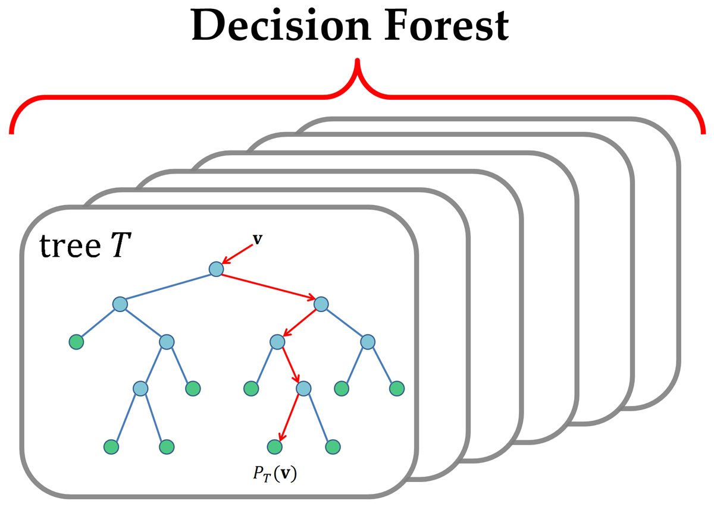
Random Forests
Ensemble approach to machine learning
Generate n trees and output the modal class
Normally uses a technique called ‘bagging’
Generate new training sets by sampling with replacement
Helps with the overfitting problem

Slide 26
But, wait…
None of this is
DEEP LEARNING

Slide 27
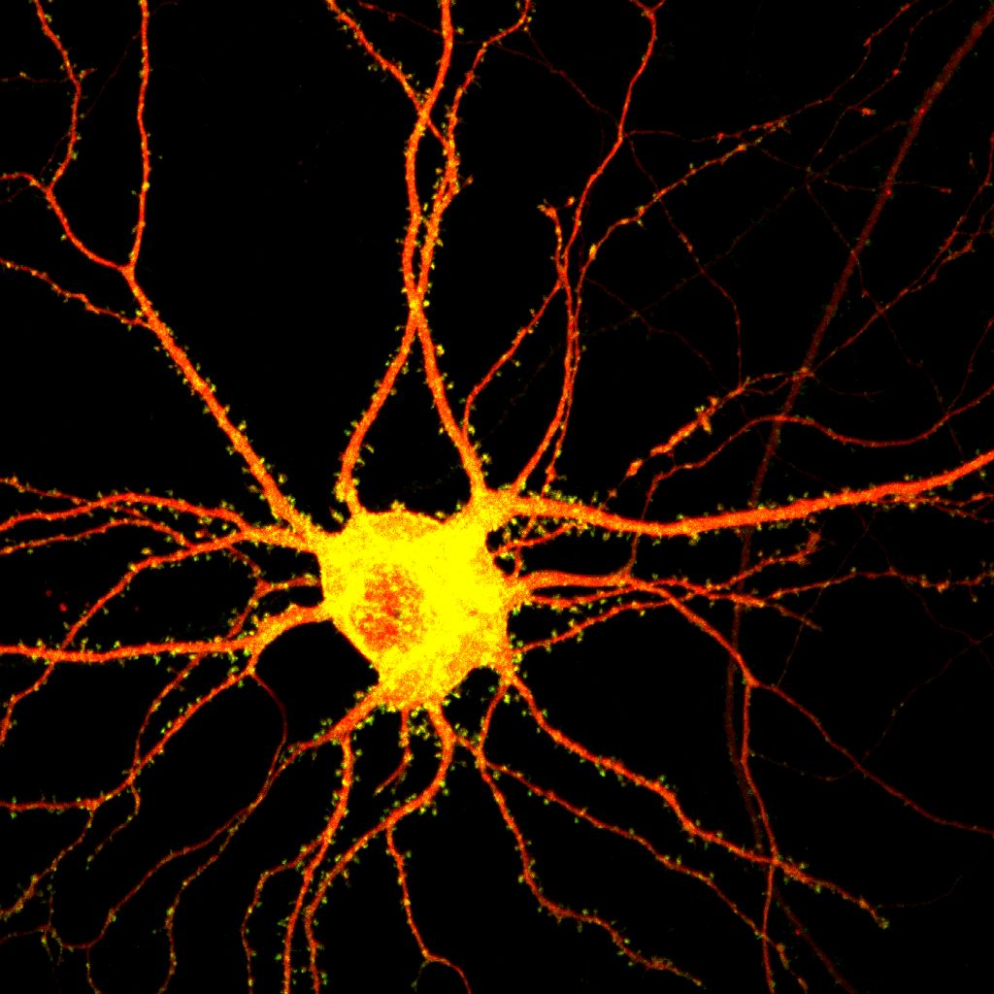

Neural Networks

Slide 28

Neuroscience 101
Basic unit of the brain is the neuron
~ 86bn neurons in the brain
Modern i7 core has 2bn transistors
About 100tn synapses
(UK National Debt is ~£1.8tn)
Has inputs and outputs
“All or nothing” activation

Slide 29
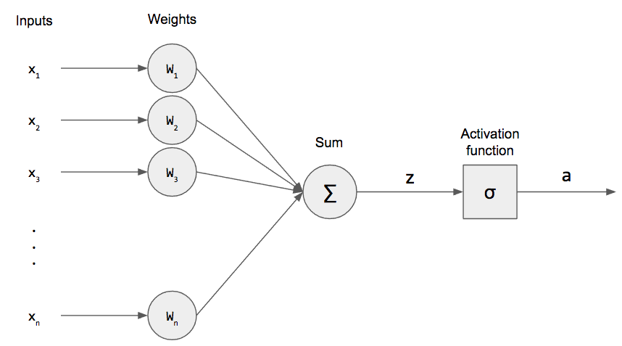

Enter the Perceptron
Each input is weighted
Output can vary (typically -1 to 1)
Common activation functions include:

Slide 30
Ok, having one perceptron is cute.
What if we had a whole brain of perceptrons?

Slide 31
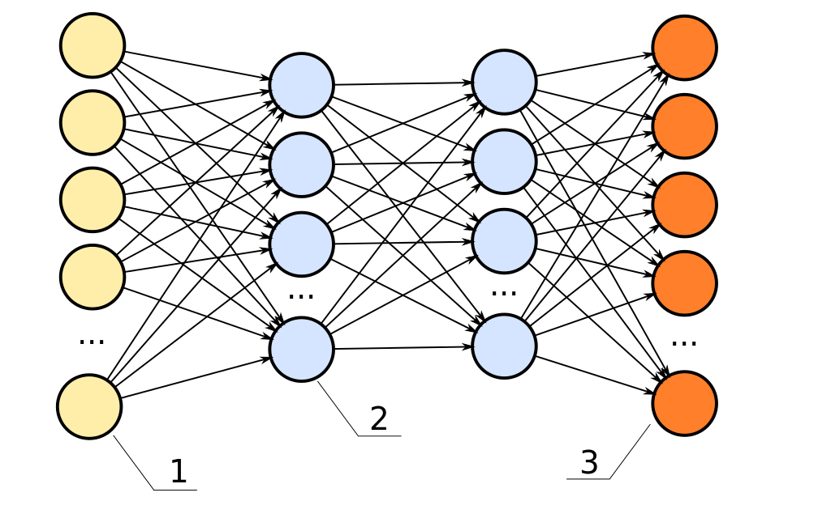
Bigger = better?
Input layer
Hidden layer(s)
Output layer

Slide 32
How do we figure out the weights?

Slide 33
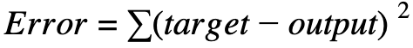
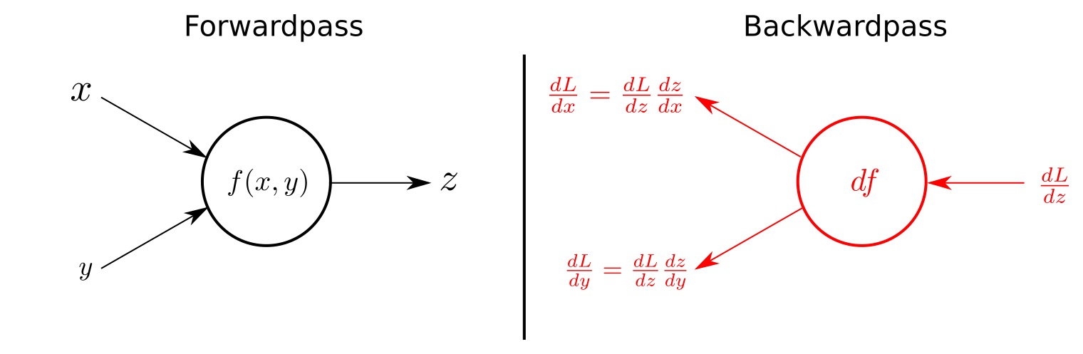
Backpropagation
Calculate the error from the output
Gradient descent on weights
How does each weight affect the output?
Differentiate the output wrt. weights
Notes:
Gradient descent - how much changing a weight will change the output
Lots of factors, so we want the partial derivative of the output with respect to each weight

Slide 34

“Deep” learning
TLDR; deep = more layers
NNs have a depth (CAP)
CAP = 2 theoretically universal
CAP > 10 “very deep” learning
(╯°□°）╯︵ ┻━┻
Notes:
CAP = Credit Assignment Path (number of hidden layers)

Slide 35
Lab session: Introduction to R

Slide 36

A disclaimer (and apology) about using R...

Slide 37
Loading Packages and Importing Data
library(“caret”)
Load the caret package
ds = read.csv(“filename.csv”)
Load the data set in the file filename.csv

Slide 38
Creating Training and Test Data Sets
index = createDataPartition(ds$feature, p=0.75, list=FALSE)
training = ds[index,]
test = ds[-index,]
Split the dataset ds into new datasets containing 75% and 25% of the data
Make sure that each set has roughly equal proportions of possible ds$feature values

Slide 39
Creating and Using a Model
model = train(training[,columns], training$target), method = 'type')
predictions = predict(object=model, test[,columns])
Train a model of a certain type on the columns and target feature of the training data set

Slide 40
Build a Predictive Policing Classifier
Your Challenge

Slide 41
Real data from ~7,000 arrests
Predict who will reoffend within 2 years

